Slide 1



Slide 2
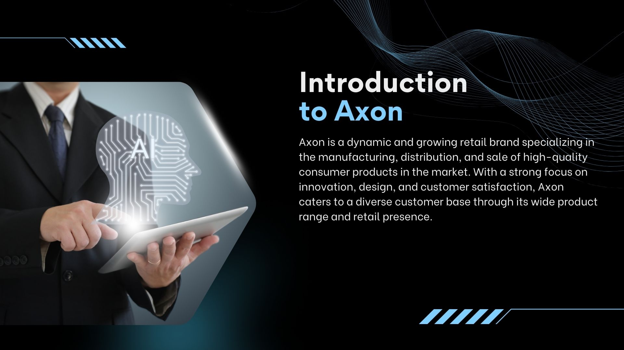

Slide 3
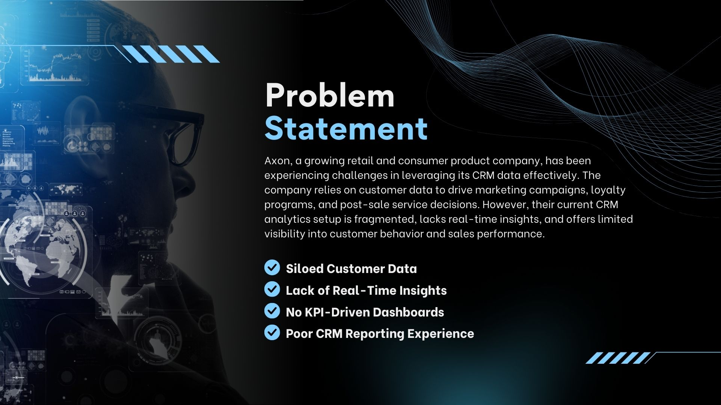

Slide 4




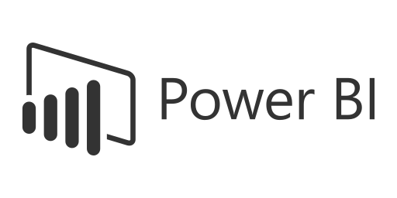



Axon Project on CRM Analytics
Mahendra Singh

Slide 5





How Project Timeline Works
Date | Time | Task Description
12-07-2025 | 10 AM – 11 AM | Project Kick-off Meeting
19-07-2025 | 10AM – 11 PM | Implementation of KPI’s using Excel
26-07-2025 | 10 AM – 11 AM | Implementation of KPI’s using Tableau/SQL/QA
02-08-2025 | 10 AM – 11 PM | Implementation of KPI’s using Power BI/SQL/QA
09-08-2025 | 10 AM – 11 PM | Final Presentation of the Project

Slide 6










PRESENTATION TOOLS
Project Steps for CRM Data Analytics
Step-by-Step Workflow for Capstone Project
Data Preparation (Excel Dashboard)
SQL Integration (Database Setup)
BI Tool Connection (Data Modeling)
Dashboard Development
Quality Assurance (QA & Validation)
Utilize the provided Excel data to create an initial dashboard.
Perform basic data cleaning and transformation.
Identify key metrics (KPIs) and define data visualization requirements.
Load the cleaned Excel files into a SQL database under a well-structured schema.
Normalize the data to maintain integrity and avoid redundancy.
Establish primary and foreign key relationships to ensure referential integrity.
Connect the SQL database to Tableau and Power BI.
Build a comprehensive data model with necessary joins and relationships.
Optimize the model for performance by indexing and aggregating data where required.
Design interactive dashboards in Tableau and Power BI.
Ensure a user-friendly interface with filters, drill-throughs, and tooltips.
Incorporate advanced analytics, such as trend analysis and forecasting.
Compare database records with dashboard visuals to ensure data accuracy.
Perform end-to-end testing of calculations and relationships.
Validate against business requirements and make necessary improvements.

Slide 7





CRM Analytics Project
Project Participant Guidelines
Empowering Communication through AI
Attendance
Team Contribution Monitoring
Active Participation Requirement
Attendance is mandatory for all participants.
Missing more than two meetings will result in your removal from the project.
All team members must actively contribute to the project.
If any team member is not contributing, it is mandatory to inform the management regularly via call, WhatsApp, email, or during weekly review meetings
Merely attending meetings without making active contributions will lead to removal from the project.
Active involvement with your group is essential for continued participation.
Tool-Specific Contributions
Weekly Review Presentations
Meeting Attendance Name
As participants in the Data Analyst/Business Analyst track, you are required to contribute to all key tools, including:
Excel, Tableau, SQL, Power BI,
PPT Presentations
Failure to contribute to even a single tool may result in your removal from the project.
Each group must present their project progress during weekly review meetings.
Consistent updates and well-prepared presentations are expected from all teams.
You must join all meetings using the same name you registered with at Excelr.
Failure to inform us about this change will result in your attendance being marked as absent.

Slide 8







TEAM OVERVIEW
Key Focus Areas for the Project Team
As we continue working on our project, I would like to highlight a few key areas that we should focus on to ensure efficiency and success
Active Contribution
Sharing Insights
01
Each team member should actively participate and engage with the team.
05
Provide your insights and suggestions to improve the overall work quality.
Timely Completion of Tasks
Collaboration Over Competition
02
Ensure that all assigned work is completed within the given deadlines.
06
Work as a team, focusing on collective success rather than individual achievements.
Clear Communication
07
Active Listening
03
This platform utilizes AI technology to quickly transform ideas into captivating presentations.
07
The founders envisioned a solution to save time while enhancing the quality of presentations.
Daily Team Connectivity
08
Recognizing Contributions
07
Acknowledge and appreciate the efforts of your teammates to boost motivation and morale.
04
Stay connected with the team on a daily basis to discuss progress and address any challenges.

Slide 9
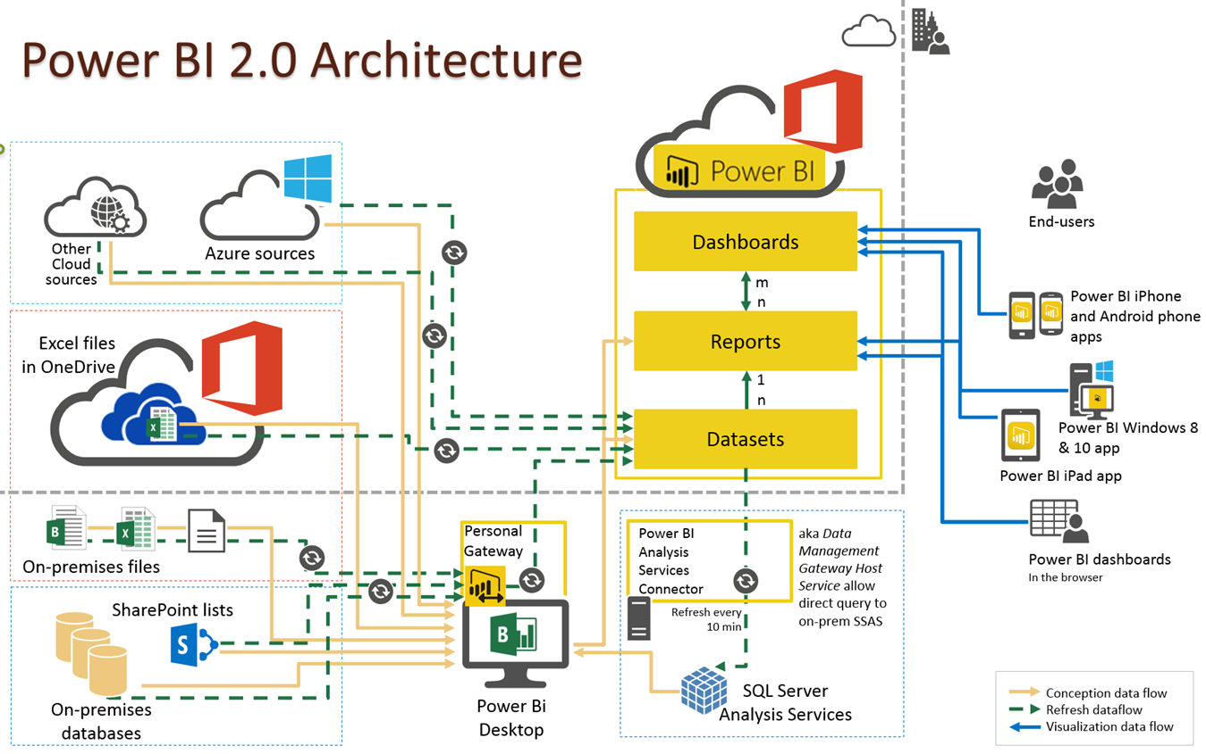


Sample: Project Architecture

Slide 10
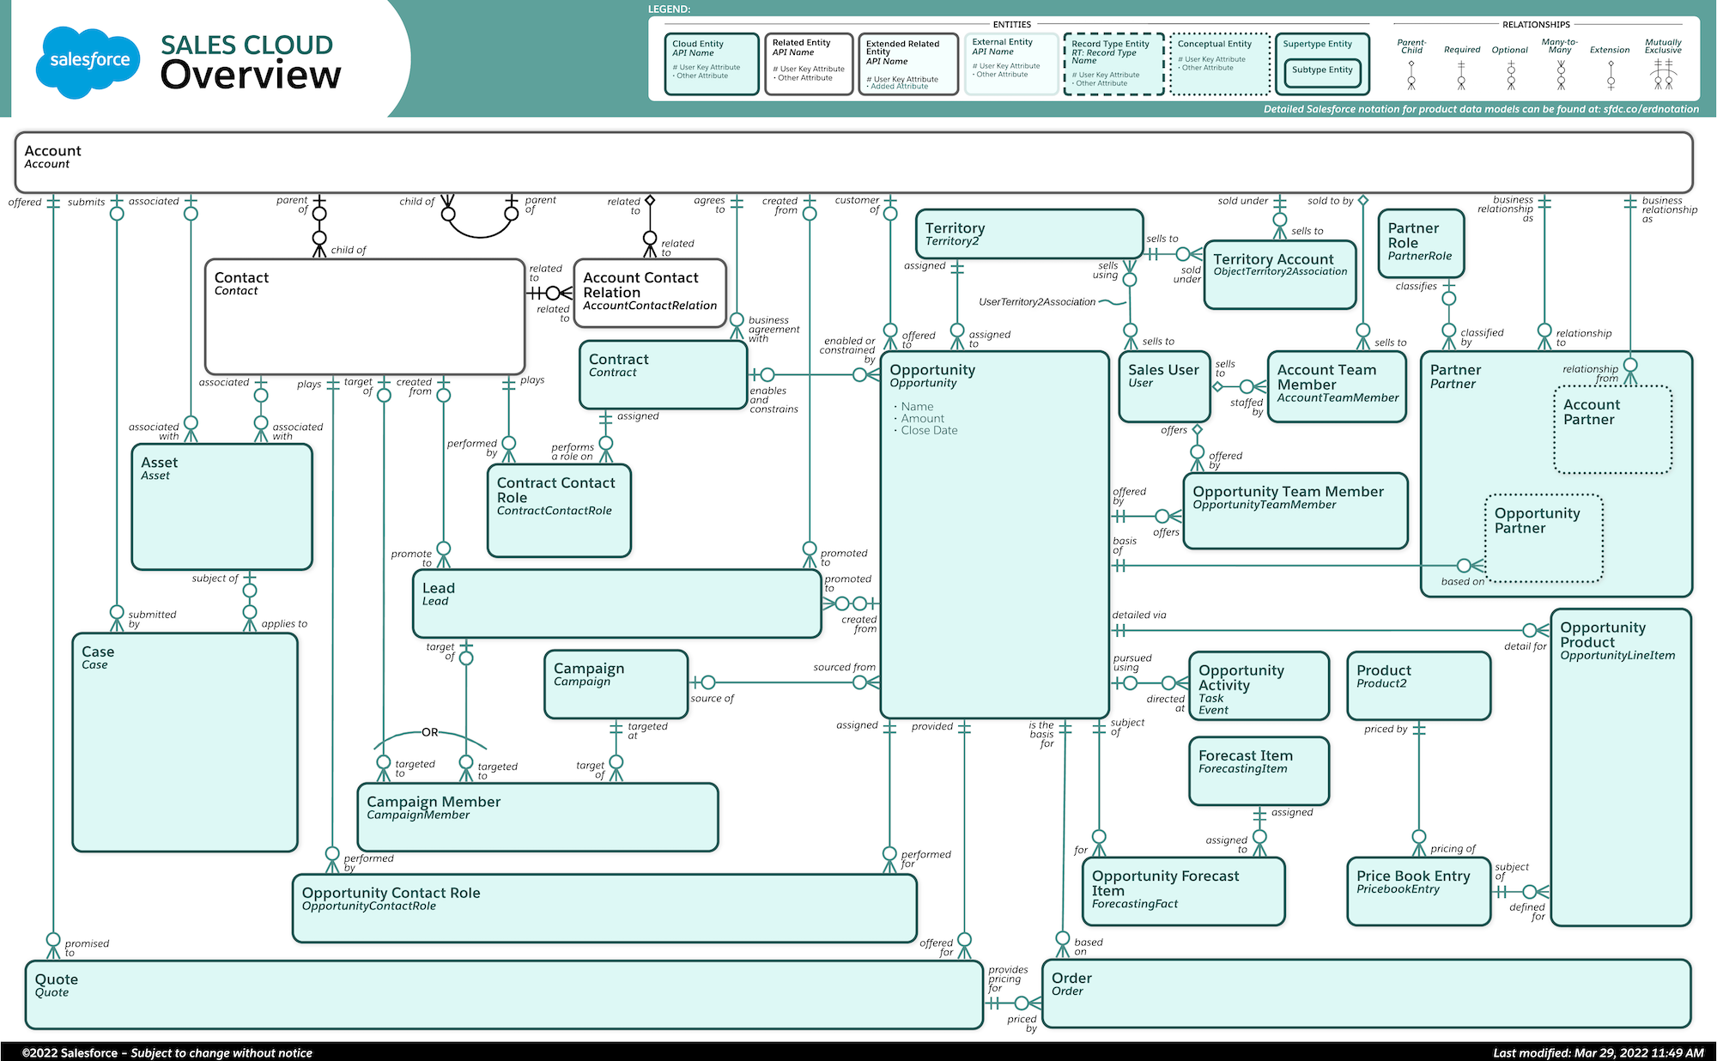

ER Data Model for Database
CRM Data Model

Slide 11
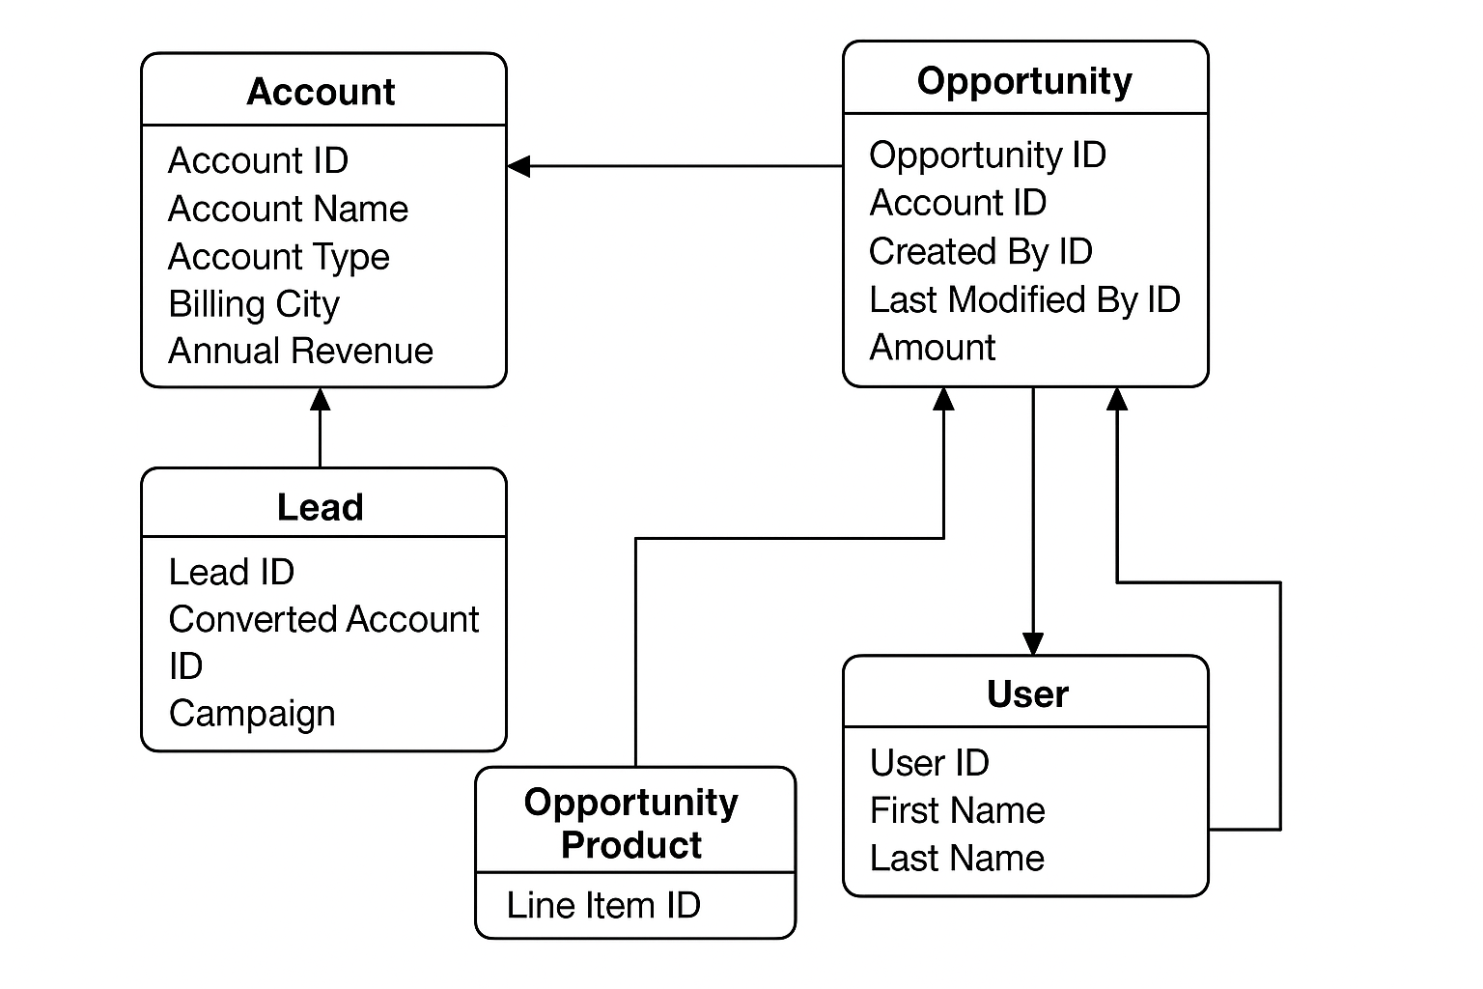
ER Data Model for Database
CRM Data Model

Slide 12
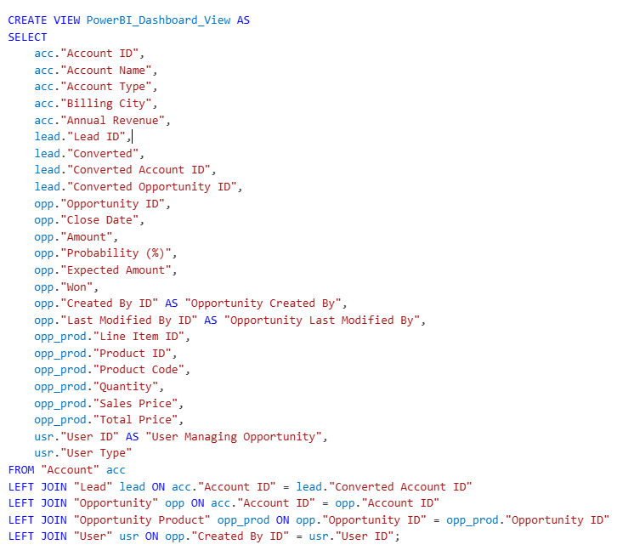
Data Model for Database
CRM Data Model

Slide 13
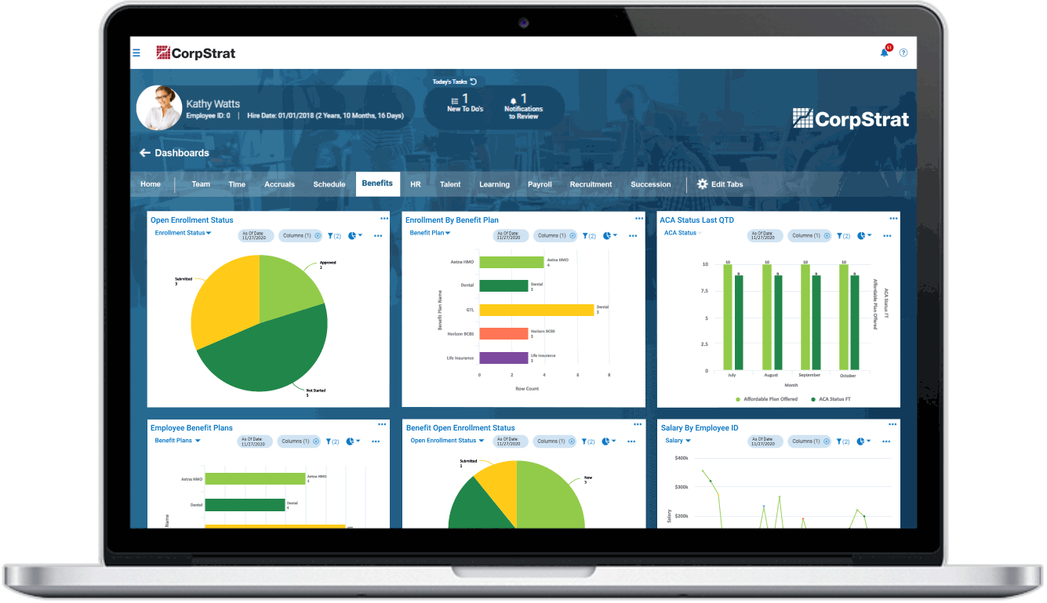
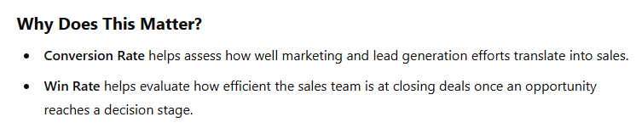
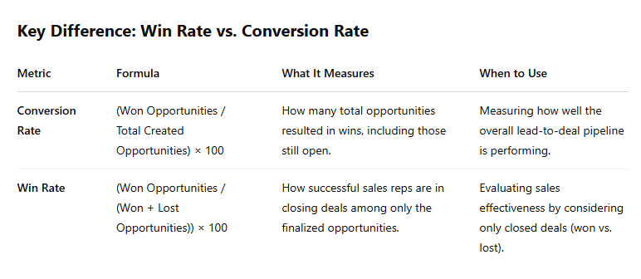
KPI for Opportunity Dashboard
KPI List
Expected Amount
Active Opportunities-Total count of open opportunities.
Conversion Rate-Conversion Rate (%)=(Win Opportunities/Total Created Opportunities​)×100
Win Rate-Win Rate (%)=(Won Opportunities/(Win +Lost)Total Opportunities​)×100
Loss Rate-Loss Rate (%)=(Closed Lost Opportunities/Total Opportunities​)×100
Trend Analysis
Expected Vs Forecast: Running total comparison of expected revenue and forecast over time.
Active Vs Total Opportunities: Cumulative active vs. total opportunities trend.
Closed Won Vs Total Opportunities: Track closed-won deals against total opportunities.
Closed Won Vs Total Closed: Analyze closed-won deals compared to all closed deals.
Expected Amount by Opportunity Type
Opportunities by Industry

Slide 14
KPI for Lead Dashboard
KPI List
Total Lead
Expected Amount from Converted Leads
Conversion Rate-Conversion Rate (%)=(Leads Converted to Customers/Total Lead​)×100
Converted Accounts
Converted Opportunities
Lead By Source
Lead By industry
Lead by Stage

Slide 15
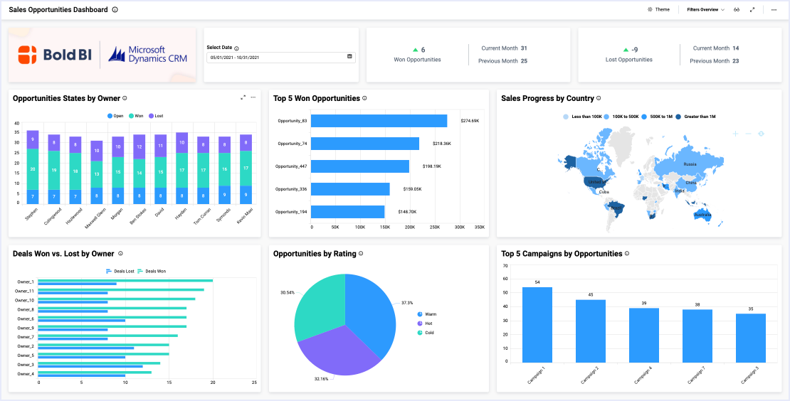

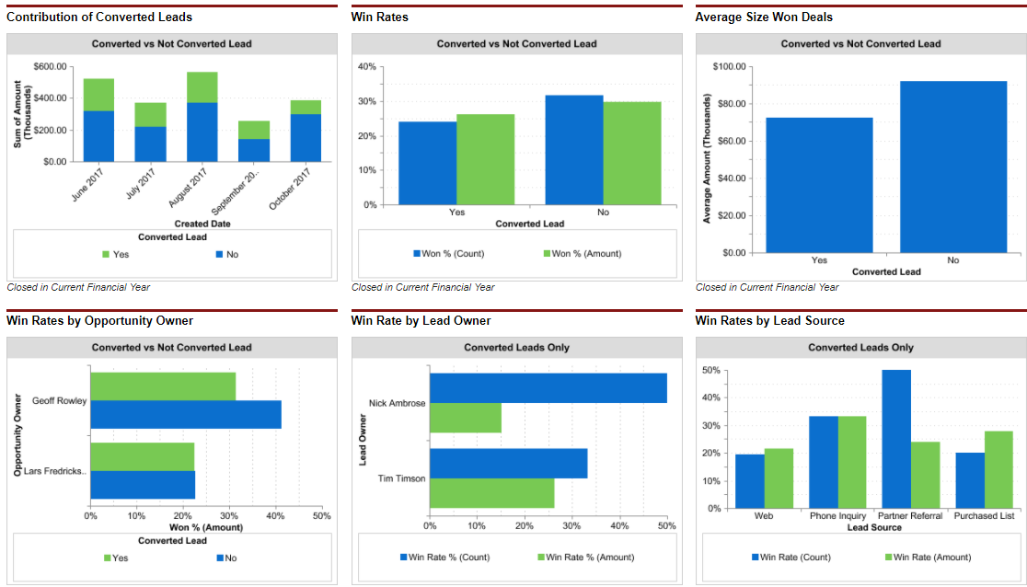

Sample Dashboard
CRM Dashboard

Slide 16



Structure the final presentation in PPT format, following a logical order
Report Preparation and final Submission
0
Final Presentation & Report Preparation
Group Details – Team members and roles.
Project Summary – Brief overview of objectives and impact.
KPI List – Key performance indicators and their business relevance.
Excel Dashboard – Initial findings and data trends.
Tableau Dashboard – Interactive visualizations and insights.
Power BI Dashboard – Advanced analytics and performance tracking.
SQL Query Image – Schema and queries used for data transformation.
Key Takeaways – Business insights, challenges, and future recommendations

Slide 17







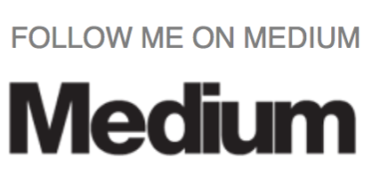



Company Wise Data Analyst Interview Questions
SQL interview Question
KEY INSIGHTS
Interview Preparation
Tableau Developer Interview Question
Power Bi Interview Question
Follow the links and prepare for the interview. If you need any help or have additional questions, I am happy to assist you on your interview preparation journey
Naukri profile Creation
Scenario Based Power BI Interview Question
Data Analyst Resume Writing
Business Analyst Interview Questions
Data Warehousing interview questions
How to import CSV into MYSQL
Let's connect on Discord for clearing doubts and getting help with interviews.
We would truly appreciate it if you could take a moment to rate the Blog and Clap and share your feedback. Your support helps us improve and continue creating quality content.
Thank you for your time and participation!

Slide 18



Always Stay in Touch
Coming together is a beginning, staying together is progress, and working together is success.
© 2025 Mahendra Singh. All rights reserved.

Slide 19

KEY INSIGHTS
Tableau Desktop Specialist
Power BI Data Analyst-PL300
Certification Preparation
Follow the links and prepare for the Certification. If you need any help or have additional questions, I am happy to assist you on your Certification preparation journey
Microsoft Fabric DP-600
You can access the test for free using the link below—no charges or sign-ups required.
PL-300
👉https://www.udemy.com/course/pl-300-power-bi-ultimate-guide/?couponCode=8C9508E75D2950AACBFF
DP-600
👉https://www.udemy.com/course/dp-600-microsoft-fabric-analytics-engineer-4-practice-test/?couponCode=78B6659A0E95C65230D9
Tableau Desktop Specialist
👉https://www.udemy.com/course/tableau-desktop-specialist-practice-test-april-2024/?couponCode=1DA0B62265565303C359
We would truly appreciate it if you could take a moment to rate the test and share your feedback. Your support helps us improve and continue creating quality content.
Thank you for your time and participation!
Let's connect on Discord for clearing doubts and getting help with Certification.

Slide 20
Always Stay in Touch
Coming together is a beginning, staying together is progress, and working together is success.
© 2025 Mahendra Singh. All rights reserved.

Slide 21


